Slide 1

PROJECT -RESEARCH
SALARY PREDICTION
CREATED BY
REENA PRAJAPATI

Slide 2
Salary Prediction Objectives
Predicting salaries is a common objective in various fields, and it involves using data and statistical methods to estimate or forecast the expected salary for individuals or groups. The objectives of salary prediction can vary depending on the context, but some common goals include:
Recruitment and Talent Acquisition:
Identify competitive salary ranges for different job positions to attract and retain top talent.
Ensure fairness and equity in compensation across various roles within the organization.
Employee Retention:
Understand salary expectations and needs of current employees to prevent turnover.
Adjust compensation strategies to retain high-performing employees.
Budgeting and Resource Planning:
Assist in budgeting by providing accurate estimates of salary expenses.
Aid in resource planning by forecasting future compensation costs based on growth and hiring plans.
4.Market Competitiveness:
Benchmark the organization's salaries against industry standards and competitors to ensure competitiveness.
Stay informed about market trends to adjust compensation strategies accordingly.
5. Personalized Compensation Packages:
Tailor compensation packages based on individual skills, experience, and performance.
Consider factors such as education, certifications, and geographic location in predicting salary.

Slide 3
6.Performance Management:
Link salary predictions to performance evaluations to reward high-performing individuals.
Provide insights into how performance metrics correlate with compensation.
7.Data-Driven Decision Making:
Utilize historical salary data and analytics to make informed decisions about compensation strategies.
Continuously refine and optimize compensation models based on real-time data.
8.Compliance and Fairness:
Ensure that salary predictions comply with legal and regulatory requirements.
Identify and rectify any biases in the salary prediction models to promote fairness.
9.Employee Satisfaction and Morale:
Consider the impact of salary predictions on overall employee satisfaction and morale.
Strive to maintain a positive and motivating work environment through fair compensation practices.
10.Continuous Improvement:
Regularly review and update salary prediction models to adapt to changing market conditions.
Seek feedback from employees to enhance the accuracy and relevance of salary predictions.
Achieving these objectives often involves the use of machine learning models, statistical analysis, and ongoing collaboration between HR professionals, data scientists, and organizational leaders. It's essential to balance quantitative data with qualitative insights to make well-informed decisions that benefit both the organization and its employees.

Slide 4
2. Data Collection and Preprocessing:
Data is collected by using website Kaggle.
https://www.kaggle.com/datasets/rkiattisak/salaly-prediction-for-beginer/
Number of Rows and Columns- 375 ,7
Duplicates values: 50 ,7
After clean data
Number of Rows and Columns- 324 ,7
List of columns, data types:
Age float
Gender object
Education_Level object
Job_Title object
Experience_years float
Salary float
Location object
Data type is : object

Slide 5
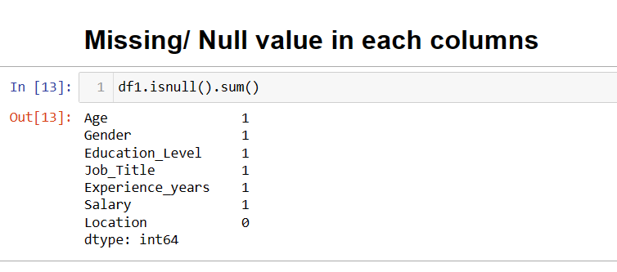
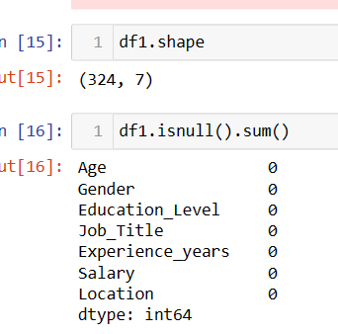
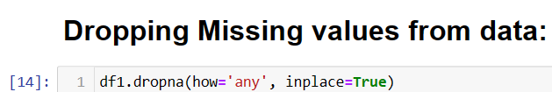
PREPROCESS:
Missing Values is 1 in all columns excepting only “location ‘’ coloumn.

Slide 6
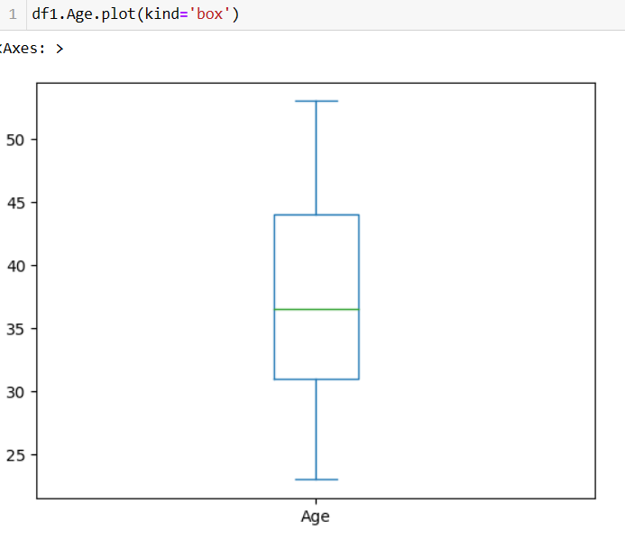
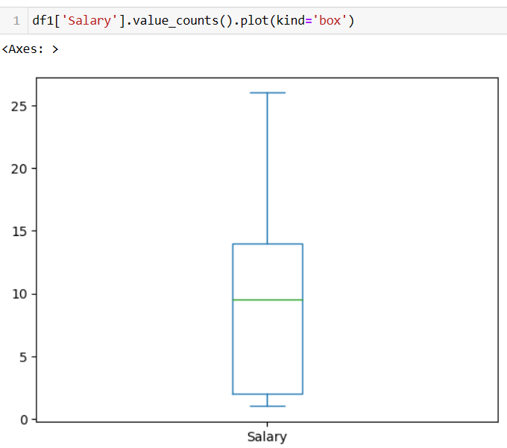
3. EXPLORATORY DATA ANALYSIS
Outlier Detection:
IN THIS DATASET ,THERE IS NO ANY DETECTED OUTLIERS FROM ALL, FOR FEW EXAMPLE IS HERE :
Outlier is assumption by using Box Plot
Here two column name Salary and Age are ploted where no any outliers.

Slide 7
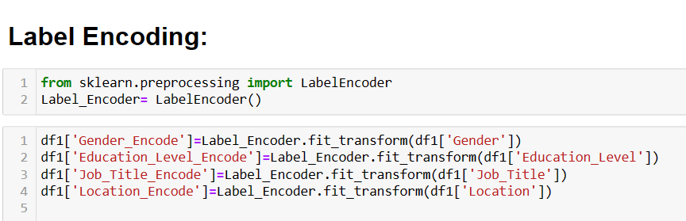
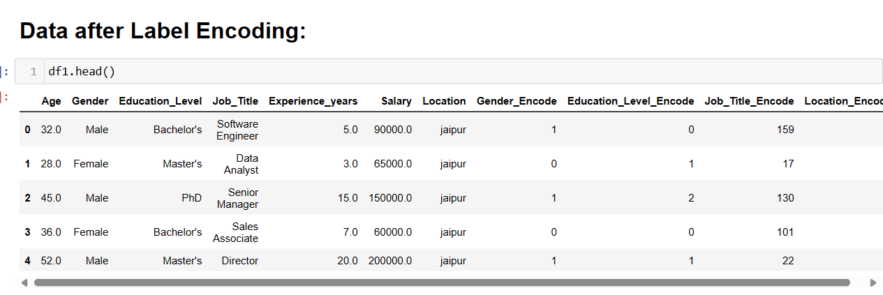
Feature Engineering:
Feature engineering is a process where all categorical values or column need to be convert into numerical values where machine learning algorithms can better performance ,it involves creating new features ,selecting relevant ones and optimizing their representation to improve the performance of a model. Effective feature engineering can significantly impact the accuracy and efficiency of machine learning models.
Label Encoding :
Label Encoder convert all categorical variables into Numerical variables ,here four variables are categorical
Before After
Gender ---------- Gender_Encode
Education_Level ----------- Education_Encode
Job_Title ---------- Job_Title
Location ----------- Location_Encode

Slide 8
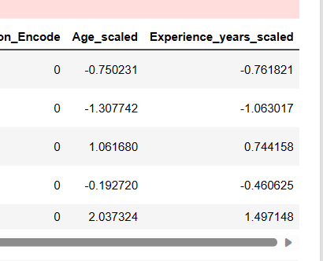
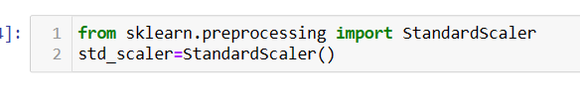
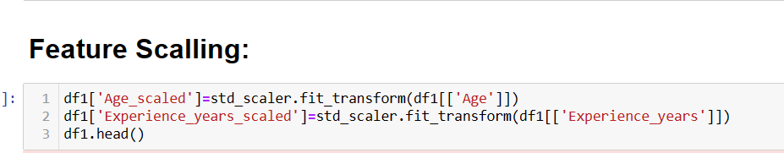
Feature Scale or Normalization:
In this process all numerical variables need to be between in a specific range or scale ,Scaler is two type:Two variables as AGE and Experience_years have broad numerical values so need to be scale else can dominant another variables
Standard Scaler (z- score): It does scale down all numerical variables where no one can be dominant on eachother, it follows ranges between (-9 to 9),(-3 to 3),(+12 to -12 {if data is highly spread }),Mostly used in Machine Learning
Standard scaler formula= X-Min/std(x)
2.Normalization( min-max scaler): Min- max scaler does Normalization extremely scale down between range( 0 to 1),Mostly used in Deep Learning
Normalization= Min-Max=X-Min(X)/Max(X)-Min(X)
Age and Experience_years after scaling

Slide 9
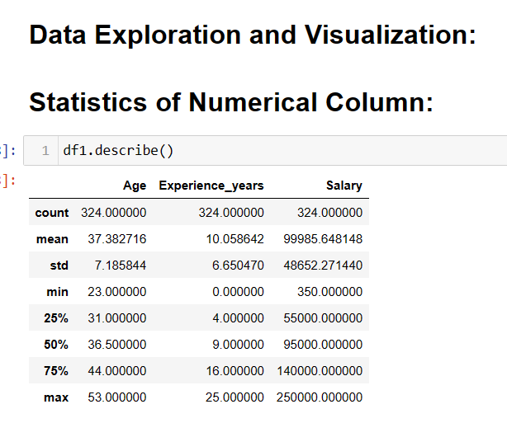
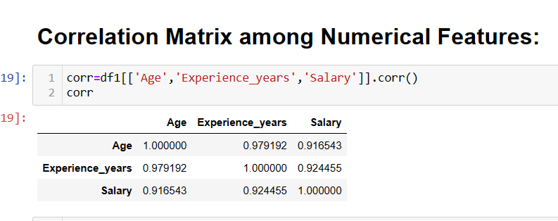
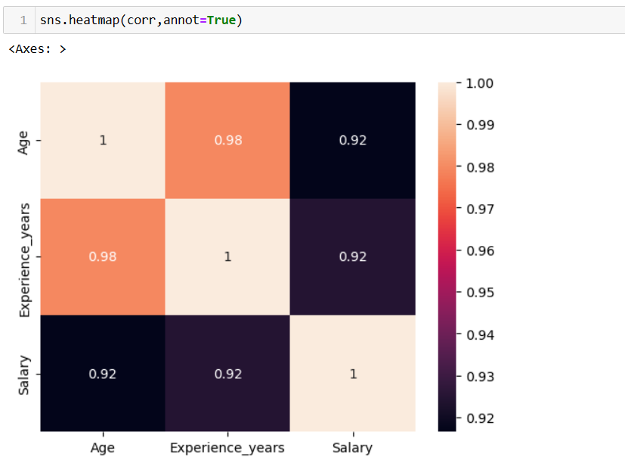
All Variables are Highly correlated to each other

Slide 10
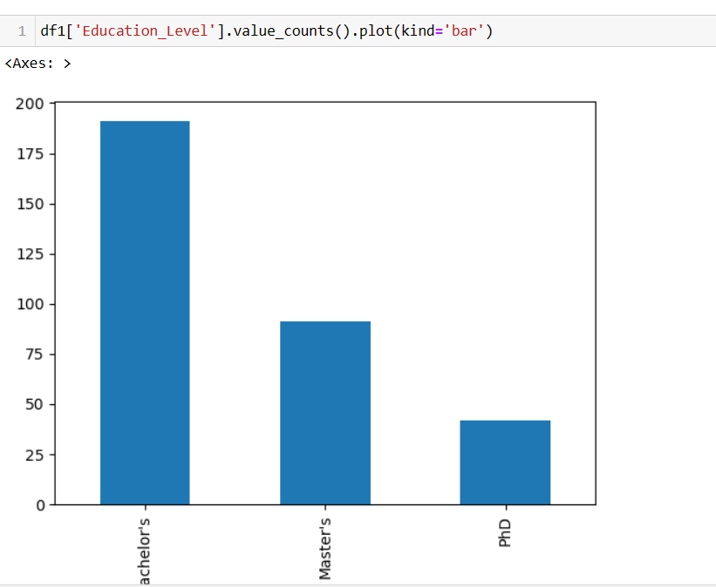
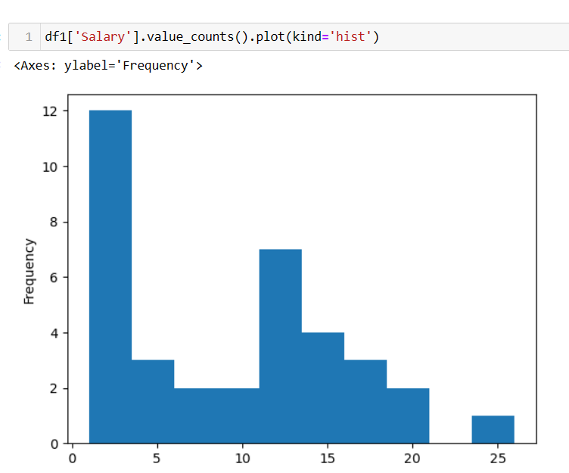

Slide 11
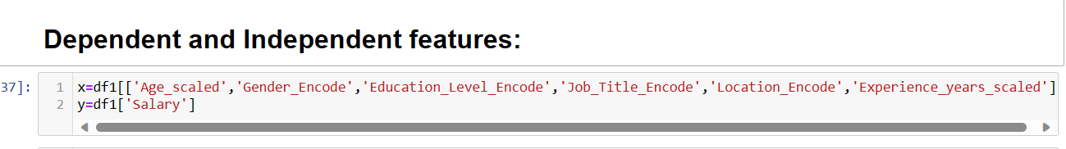
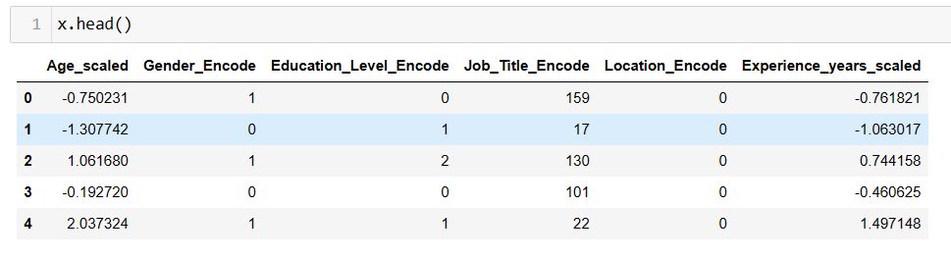
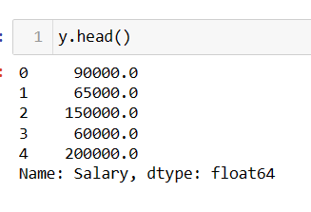
DATA SPLITTING

Slide 12
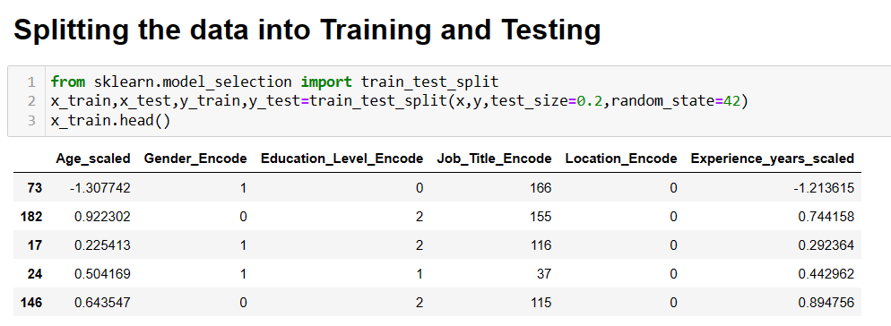
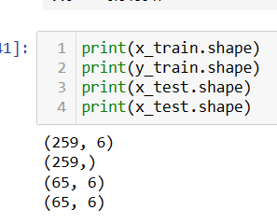

Slide 13
MODEL DEVELOPMENT
We can choose appropriate machine learning or statical modelling techniques for salary prediction .common models include
LINEAR REGRESSION
DECISION TREE
RANDOM FOREST
GRADIENT BOOSTING
NEURAL NETWORK

Slide 14
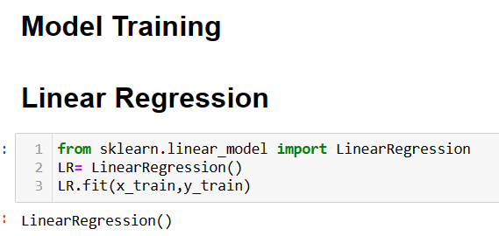
MODEL TRAINING
Model training is the process of teaching a machine learning model , to recognize pattern and make predictions based on input data. For language models , this involves exposing the model to vast amounts of text data and adjusting its parameters to minimize the difference between its predictions and actual data. The goal is for the model to learn the underlying patterns and relationships within the data, enabling it to generate coherent and contextually relevant responses. For example here I am explaining only one model among all model
LINEAR REGRESSION

Slide 15
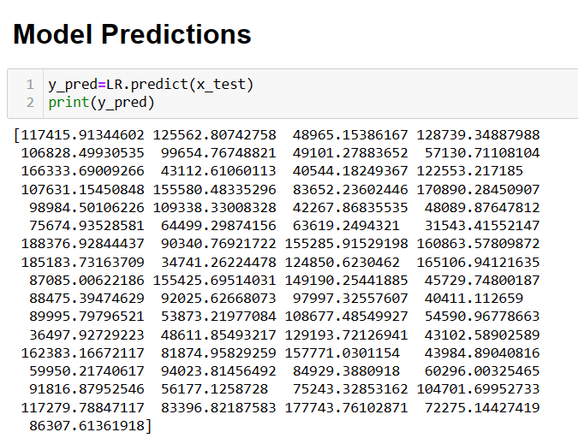
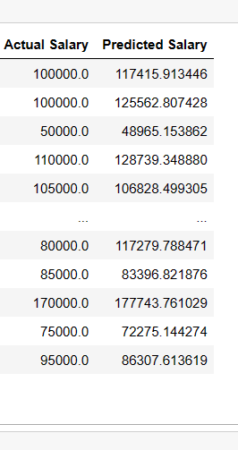
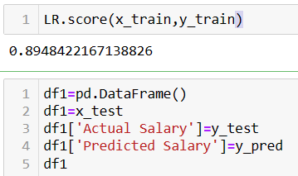

Slide 16

Mean Absolute Error (MAE)
Mean Absolute Error (MAE) is a metric used to measure the average absolute differences between predicted values and actual values in a set of observations. It is a common evaluation metric in regression analysis and is particularly useful when the data set contains outliers.
The formula for Mean Absolute Error is
Where:
n is the number of observations in the data set.
yi​ is the actual or observed value for the i-th observation.
y^​i​ is the predicted value for the i-th observation.
⋅∣ denotes the absolute value.
In simpler terms, you calculate the absolute difference between each predicted and actual value, sum up these absolute differences, and then take the average. The result is the mean absolute error, which provides a measure of the average magnitude of errors between predictions and actual values. Lower MAE values indicate better model performance.

Slide 17
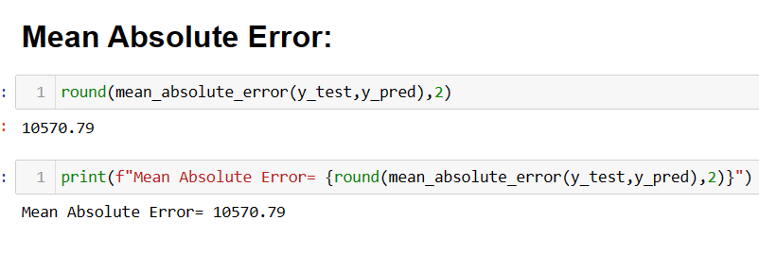
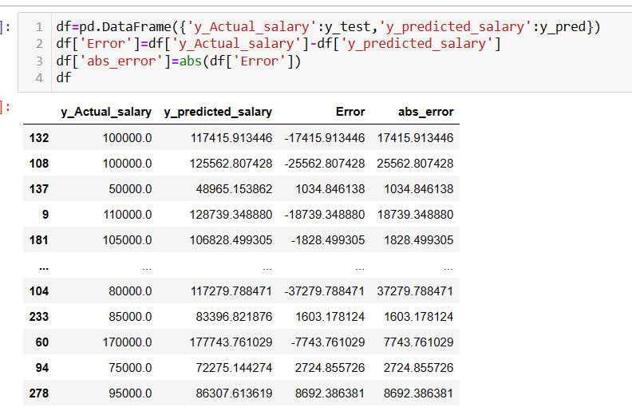
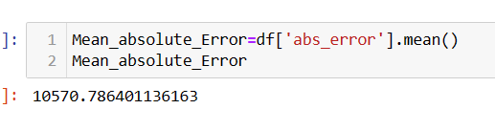

Slide 18
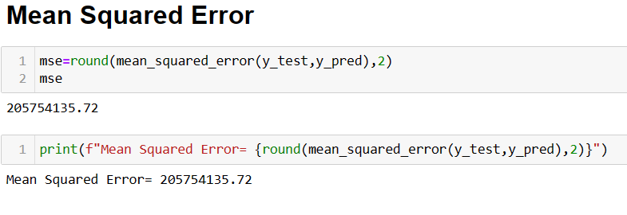

Mean Squared Error (MSE)
is another commonly used metric in regression analysis to measure the average of the squared differences between predicted values and actual values in a set of observations. It is especially sensitive to large errors due to the squaring operation, which makes it more influenced by outliers compared to Mean Absolute Error (MAE).
The formula for Mean Squared Error is:
Where:
n is the number of observations in the data set.
yi​ is the actual or observed value for the i-th observation.
^y^​i​ is the predicted value for the i-th observation.
In simpler terms, you calculate the squared difference between each predicted and actual value, sum up these squared differences, and then take the average. The result is the mean squared error, which provides a measure of the average magnitude of squared errors between predictions and actual values.
MSE is commonly used in the training of regression models, and when comparing models, a lower MSE indicates better performance. However, one drawback of MSE is that the values are not in the same unit as the original data, making interpretation less intuitive.

Slide 19
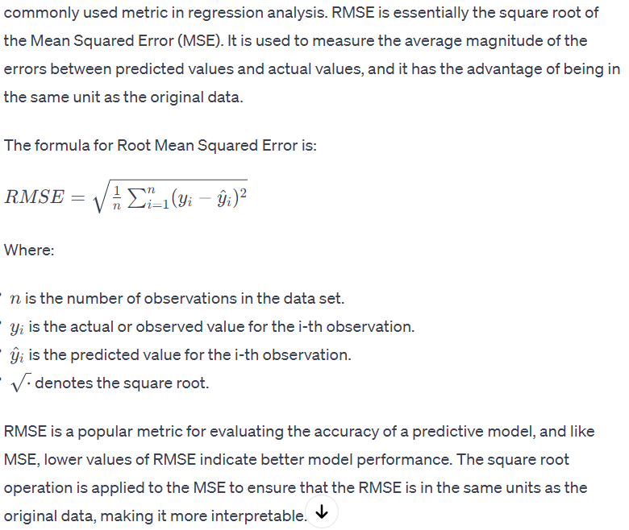
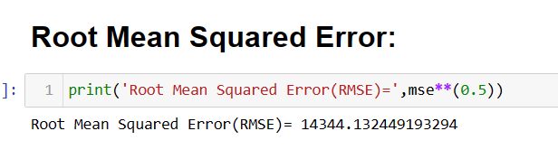
Root Mean Squared Error

Slide 20
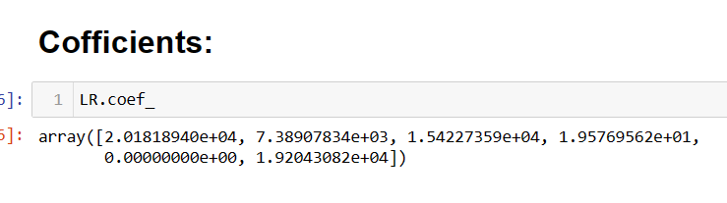
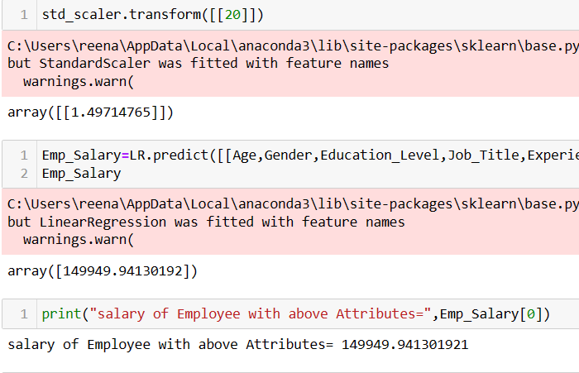
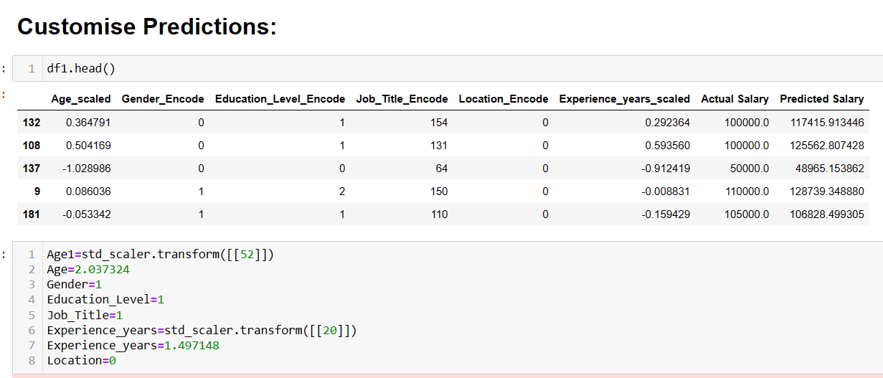
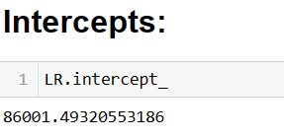

Slide 21
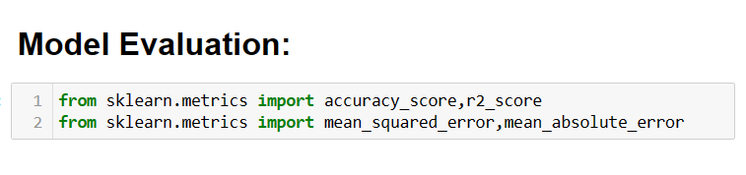
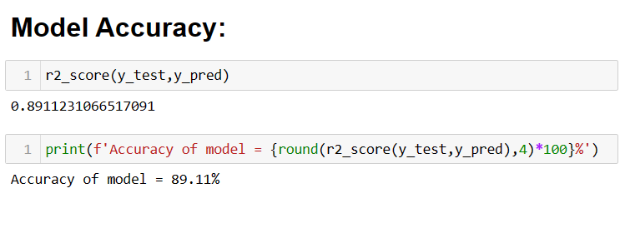
EVALUATION
In machine learning and data science, evaluation involves assessing the performance of models and algorithms. Metrics like accuracy, precision, recall, F1 score, Mean Absolute Error (MAE), Mean Squared Error (MSE), and others are commonly used for model evaluation.

Slide 22
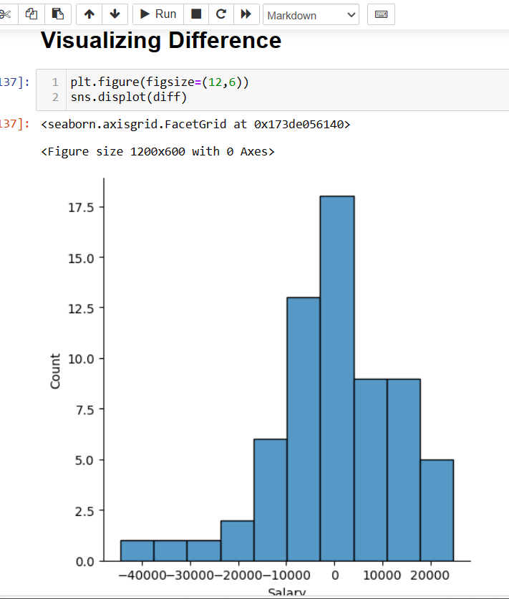
DECISION TREE REGRESSION MODEL
ACCURACY OF MODEL IS = 97.26%
MEAN SQUARED ERROR(MSE)= 249579251.05
ROOT SQUARED ERROR(RMSE) = 15798.077
2. RANDOM FOREST REGRESSOR
ACCURACY OF MODEL IS = 98.98%
MEAN SQUARED ERROR(MSE)= 167950412.34
ROOT SQUARED ERROR(RMSE) = 12959.56
MEAN ABSOLUTE ERROR (MAE) = 9358.25
RANDOM FOREST VISUALIZATION

Slide 23
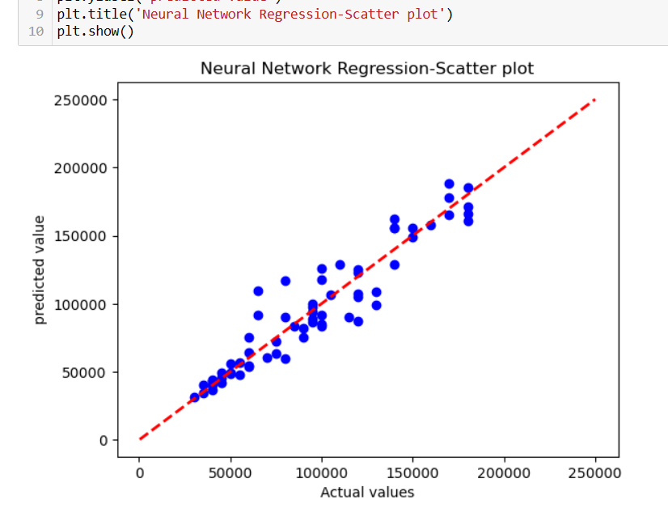
GRADIENT BOOSTING MODEL
ACCURACY SCORE = 90.92
NEURAL NETWORK REGRESSION
MEAN SQUARED ERROR = 85355382428.425304

Slide 24
RESULTS AND CONCLUSION
The best salary prediction model is RANDOM FOREST REGRESSOR with highest accuracy score 98.88%

Slide 25
THANK YOU

